Slide 1

BioCalc
Through the dark waters of the javascript inheritance
Alexandru Iuga
Braşov, September 2013

Slide 2
Agenda
Introduction
BioCalc Application
Inheritance
Public, Private, Protected
Adapter Pattern
© iQuest Group 2013. All rights reserved.

Slide 3
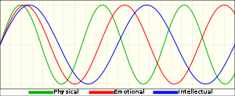

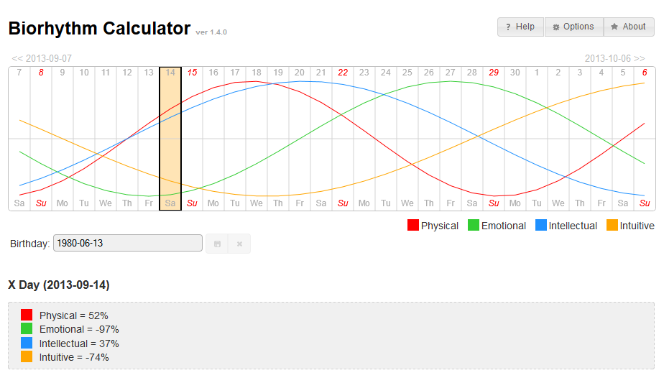
Introduction
What are the biorhythms?
http://en.wikipedia.org/wiki/Biorhythm
What is BioCalc?
[show in browser]
© iQuest Group 2013. All rights reserved.

Slide 4
Agenda
Introduction
BioCalc Application
Inheritance
Public, Private, Protected
Adapter Pattern
© iQuest Group 2013. All rights reserved.

Slide 5
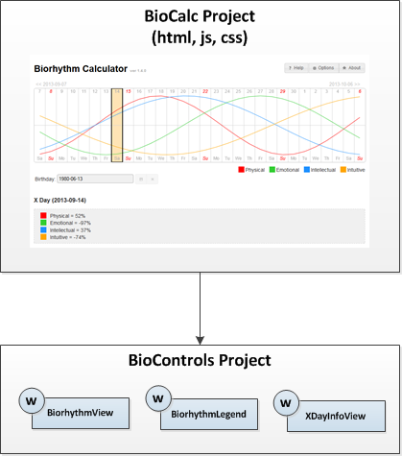
BioCalc Application
[show code]
© iQuest Group 2013. All rights reserved.

Slide 6
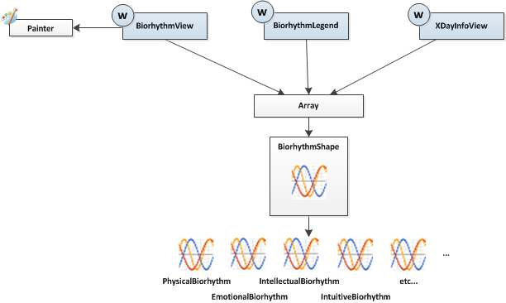
BioCalc Application – BioControls Project
BioControls Project
© iQuest Group 2013. All rights reserved.

Slide 7
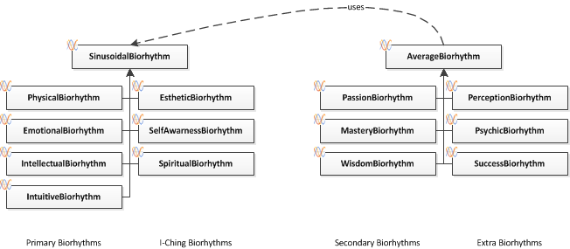
BioCalc Application
The Biorhythms hierarchy
[show code]
© iQuest Group 2013. All rights reserved.

Slide 8
Agenda
Introduction
BioCalc Application
Inheritance
Public, Private, Protected
Adapter Pattern
© iQuest Group 2013. All rights reserved.

Slide 9
Inheritance – (Function Call)
How javascript runtime calls a function
function myFunction() {}
myFunction(); ⬄ myFunction.call(window);
myFunction.call(null); // ES5
myFunction(param); ⬄ myFunction.call(window, param);
myFunction.call(null, param); // ES5
var obj = {
myMethod: myFunction
};
obj.myMethod(); ⬄ myFunction.call(obj);
obj.myMethod(param); ⬄ myFunction.call(obj, param);
© iQuest Group 2013. All rights reserved.

Slide 10
Inheritance – (Object Creation)
1) Object literal
var cat = {};
2) Using new operator
function Cat() {}
var cat = new Cat();
3) Using the Object.create() function
var cat = Object.create(animal);
© iQuest Group 2013. All rights reserved.

Slide 11
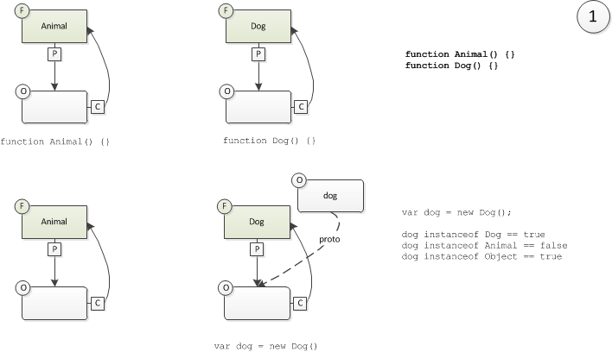
Inheritance – Basic
Create two functions (Animal and Dog)
© iQuest Group 2013. All rights reserved.

Slide 12
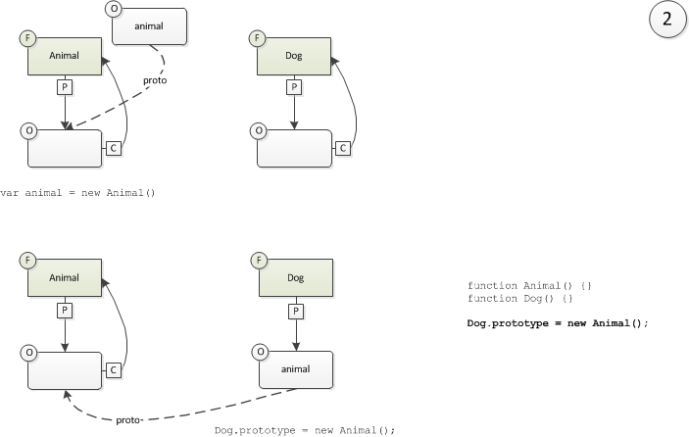
Inheritance – Basic
Set the prototype property of the Dog function
© iQuest Group 2013. All rights reserved.

Slide 13
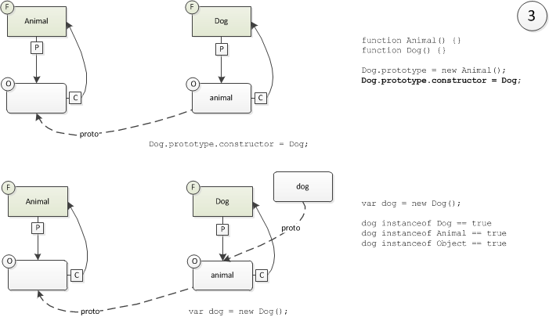
Inheritance – Basic
Fix the „constructor” property of the Dog function
But what if...
© iQuest Group 2013. All rights reserved.

Slide 14
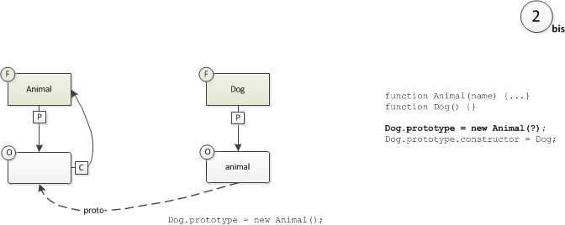
Inheritance – Basic
... The prototype’s constructor has parameters
We cannot call the Animal constructor here.
© iQuest Group 2013. All rights reserved.

Slide 15

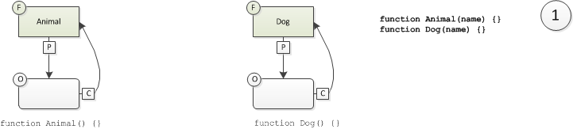
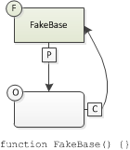
Inheritance – With Parameters
Create the constructor function named FakeBase
We’ll use the parameterless FakeBase constructor instead of the Animal constructor.
© iQuest Group 2013. All rights reserved.

Slide 16
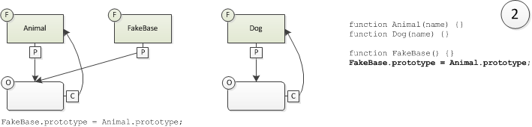
Inheritance – With Parameters
Set the prototype property of the FakeBase function
© iQuest Group 2013. All rights reserved.

Slide 17
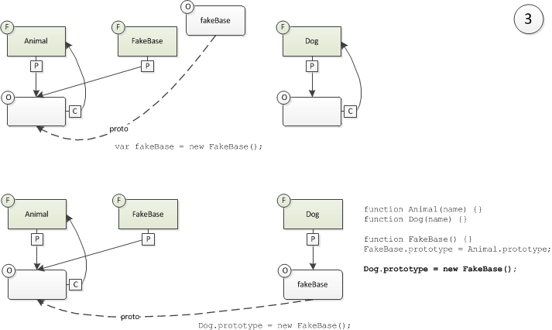
Inheritance – With Parameters
Set the prototype property of the Dog function
© iQuest Group 2013. All rights reserved.

Slide 18
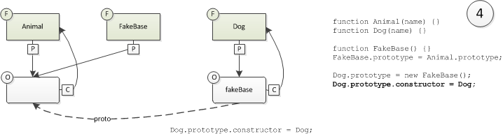
Inheritance – With Parameters
Fix the „constructor” property of the FakeBase function
© iQuest Group 2013. All rights reserved.

Slide 19
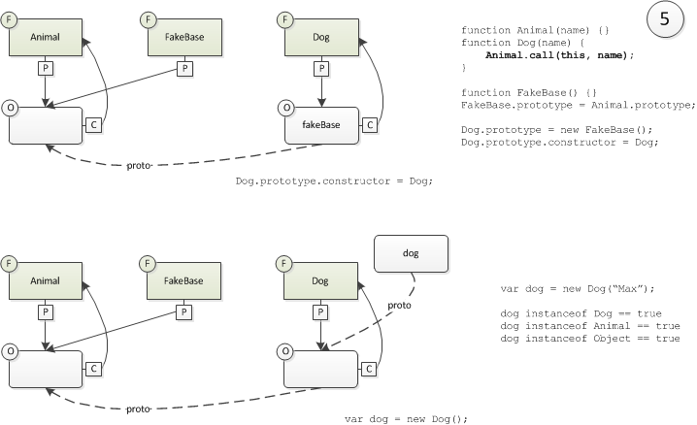
Inheritance – With Parameters
Call base constructor.
© iQuest Group 2013. All rights reserved.

Slide 20
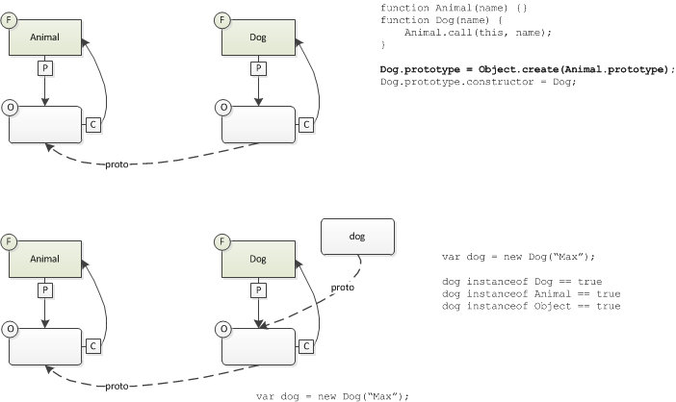
Inheritance – With Parameters
In ECMA Script 5
[show code: Biorhythm inheritance]
© iQuest Group 2013. All rights reserved.

Slide 21
Inheritance – Conclusion
Inheritance – no params
function Animal() {}
function Dog() {}
Dog.prototype = new Animal();
Dog.prototype.constructor = Dog;
Inheritance – with params
function Animal(name) {}
function Dog(name) {
Animal.call(this, name);
}
Dog.prototype = Object.create(Animal.prototype);
Dog.prototype.constructor = Dog;
[show code: Biorhythm inheritance]
© iQuest Group 2013. All rights reserved.

Slide 22
Agenda
Introduction
BioCalc Application
Inheritance
Public, Private, Protected
Adapter Pattern
© iQuest Group 2013. All rights reserved.

Slide 23
Public members
How we create public members?
Easy.
[jsfiddle: Virtual public methods]
© iQuest Group 2013. All rights reserved.

Slide 24
Private members
How we create private members?
We cannot, but we can emulate them.
[jsfiddle: Private methods]
© iQuest Group 2013. All rights reserved.

Slide 25
Protected members
How we create protected members?
We cannot.
© iQuest Group 2013. All rights reserved.

Slide 26
Alternative to private and protected members
Alternative to private and protected members
1. Create all as public;
2. Use a naming convention for “private” and “protected” ones.
jQuery uses underscore for “private” members:
Example: this._paint();
© iQuest Group 2013. All rights reserved.

Slide 27
Public, Private, Protected
Conclusion
Member type | Can be created
public | yes
private | emulate
protected | no
© iQuest Group 2013. All rights reserved.

Slide 28
Agenda
Introduction
BioCalc Application
Inheritance
Public, Private, Protected
Adapter Pattern
© iQuest Group 2013. All rights reserved.

Slide 29
Duck Typing
C#
JavaScript
public interface IMyInterface()
{
void MyFunction();
}
We don’t have interfaces
var myObj = obj as IMyInterface;
if (myObj != null)
{
myObj.MyFunction();
}
if (typeof myObj.myFunction === "function") {
myObj.myFunction();
}
“If it walks like a duck and it quacks like a duck then it’s a duck.”
© iQuest Group 2013. All rights reserved.

Slide 30
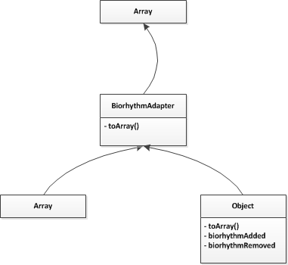
BiorhythmAdapter Object
[show code]
© iQuest Group 2013. All rights reserved.

Slide 31
Links
Wikipedia Biorhythm page:
http://en.wikipedia.org/wiki/Biorhythm
BioCalc Github page:
https://github.com/lastunicorn/BioCalcJs
or
http://github.com -> search for BioCalc
© iQuest Group 2013. All rights reserved.

Slide 32

The end
© iQuest Group 2013. All rights reserved.

